Slide 1

Project Presentation On Data Security in Cloud Computing
Under the guidance of Prof. Runa Seth Asst. Professor DEPARTMENT OF CSE
NSEC
By Debkumar Giri Santanu Das Ankan Mazumdar

Slide 2
Contents
Abstract
Introduction
Algorithms
Previous Works
Proposed Model
Hardware & Software constraints
Screenshots
Advantages
Future Works
Conclusion
References

Slide 3
Abstract
Cloud computing is one the most important and developing concept for both the developers and the users
Resources are shared among all of the servers, users and individuals.
In the area of cloud computing different security models and algorithms are applied
we have proposed new security architecture for cloud computing platform
In this model high ranked security algorithms are used for giving secured communication process

Slide 4
Introduction
In Cloud computing technology , the most important issue is security and how cloud provider assures it.
Cloud computing focuses a new challenging security threats. Therefore, a data security model must solve the most challenges .
Default gateway platform encrypts sensitive data automatically in a real time
Unauthorized person only sees encrypted data. Authorized person accesses successfully in his cloud, the data is decrypted in real time for use.

Slide 5
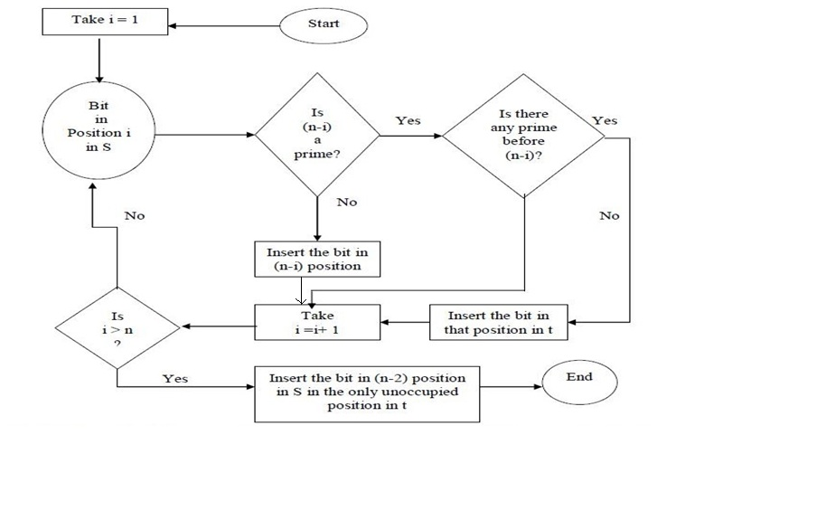
Activity Diagram of RPSPNC Algorithm

Slide 6
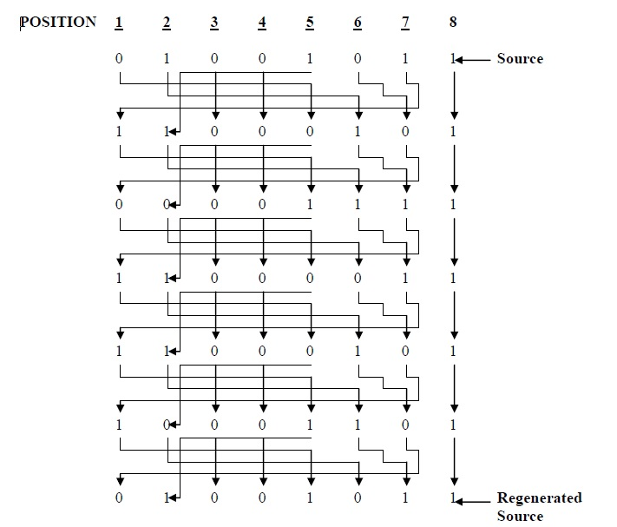
Example of RPSPNC:

Slide 7
Triangular Algorithm:-
It is a symmetric block cipher
It uses the same key for both encryption and decryption
TE is a bit level technique
Boolean operation is use(exclusive NOR (XNOR))
It is to be applied to generate the corresponding target block
After formation shape putting together either the MSBs or the LSBs of all blocks
Decryption: Exactly the same encryption process to be followed

Slide 8
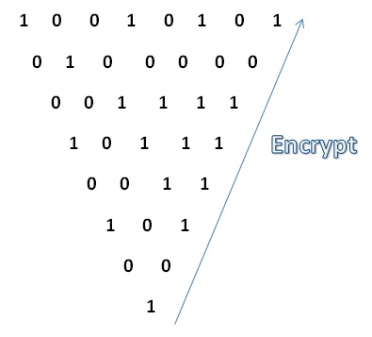
Example of Triangular Algorithm:-

Slide 9
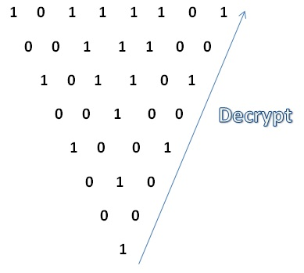
Example of Triangular Algorithm:-

Slide 10
MD5 Hashing Algorithm:-
MD5 processes a variable-length message into a fixed-length output of 128 bits
The input message is broken up into chunks of 512-bit blocks sixteen 32-bit words; the message is padded so that its length is divisible by 512
The main MD5 algorithm operates on a 128-bit state, divided into four 32-bit words
The main algorithm then uses each 512-bit message block in turn to modify the state
The processing of a message block consists of four similar stages, termed rounds

Slide 11
One time password:-
A one-time password (OTP) is a password that is valid for only one login session or transaction, on a computer system or other digital device.
The most important advantage that is addressed by OTPs is that, in contrast to static passwords, they are not vulnerable to replay attacks.
Based on time-synchronization between the authentication server and the client providing the password (OTPs are valid only for a short period of time)
Using a mathematical algorithm to generate a new password based on the previous password (OTPs are effectively a chain and must be used in a predefined order).

Slide 12
Previous work:-
Identification based cloud computing security model have been worked out by different researchers
RSA, being a public key cryptosystem, is slower than its private key counterparts. Takes more time to Encrypt /Decrypt..
DES based file encryption system is used in some of these models. Takes more frequent repetition of plain text.
Only one successful malicious attack in the server may open the whole information files to the hacker.

Slide 13
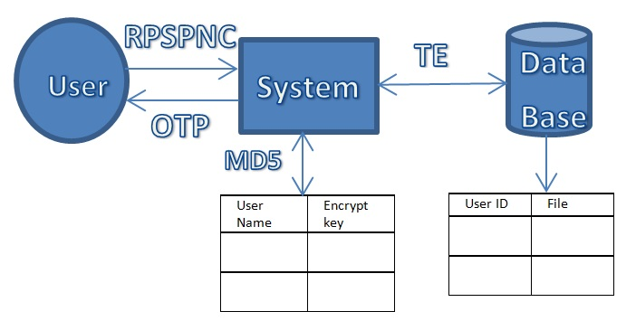
Proposed model:-

Slide 14
Contd.
In our proposed model we have worked with the following security algorithms:-
RPSPNC algorithm for cover the tables from user
Triangular algorithm for Secured file encryption
MD5 hashing for secure password
One time password for authentication

Slide 15
Hardware & Software Constraints:
Hardware Constraints:
Client side: System, RAM 2GB, HDD 500GB, INTEL i3
Server side :System, RAM 8G, HDD 500TB, INTEL i7
Software Constraints:
Front End
Browser (Google chrome, Mozilla Firefox, etc.).
Back End
Eclipse.
Web Server
Apache Tomcat 6.
Database
My sql.

Slide 16
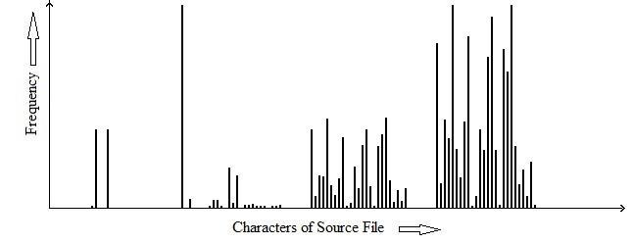
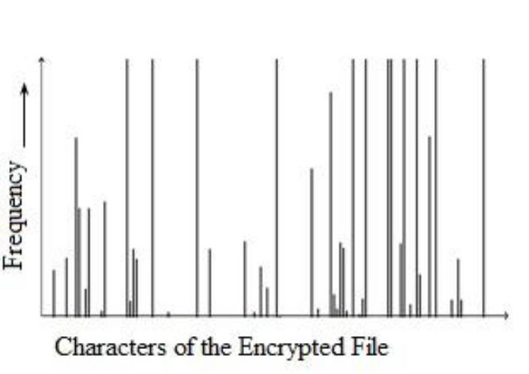
Result and Analysis
RSA VS RPSPNC
FREQUENCY DISTRIBUTION GRAPH
The frequency distribution graph of RSA encrypted file
Frequency distribution of source file

Slide 17
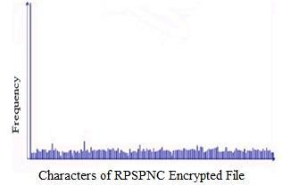
Contd.
 | File | Chi-Square Values |  | Degree |  | of
Source File | Size |  |  | freedom
 | (Bytes) | RSA | RPSPNC | RSA |  | RPSPNC
license.txt | 17,632 | 5668 | 7058 | 64 |  | 254
cs405(ei).txt | 25,422 | 2654 | 88395 | 66 |  | 254
acread9.txt | 35,121 | 447984 | 581067 | 73 |  | 255
deutsch.txt | 47,829 | 685963 | 1840256 | 77 |  | 255
genesis.txt | 49,600 | 3318506 | 6091523 | 75 |  | 255
pod.txt | 69,981 | 694410 | 6916935 | 76 |  | 255
mspaint.txt | 136,463 | 2667664 | 8608307 | 88 |  | 255
cmd.txt | 152,028 | 2216429 | 9514025 | 73 |  | 245
d3dim.txt | 193,189 | 906300 | 9930856 | 10 |  | 255
clbcatq.txt | 403,901 | 3896171 | 9968012 | 11 |  | 255
The frequency distribution graph of RPSPNC encrypted file
Chi-Square values of RSA and RPSPNC

Slide 18
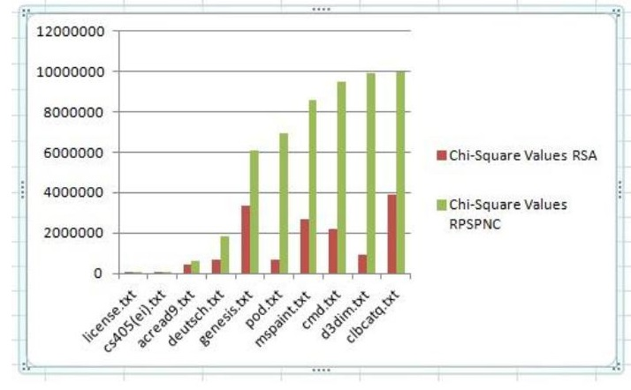
NON-HOMOGENEITY TEST
Graphical representation of Chi-Square value of RSA and RPSPNC

Slide 19
TIME COMPLEXITY ANALYSIS
 | File | Encryption Time |  | Decryption Time
Source File | Size | RSA | RPSPNC | RSA | RPSPNC
 | (Bytes)
license.txt | 17,632 | 0.01 | 0.01 | 0.28 | 0.18
cs405(ei).txt | 25,422 | 0.06 | 0.03 | 0.30 | 0.20
acread9.txt | 35,121 | 0.07 | 0.05 | 1.67 | 0.90
deutsch.txt | 47,829 | 0.11 | 0.10 | 3.51 | 2.90
genesis.txt | 49,600 | 0.12 | 0.11 | 5.06 | 2.55
pod.txt | 69,981 | 0.12 | 0.11 | 4.34 | 3.60
mspaint.txt | 136,463 | 0.20 | 0.21 | 8.37 | 4.80
cmd.txt | 152,028 | 0.25 | 0.21 | 6.59 | 6.33
d3dim.txt | 193,189 | 0.28 | 0.23 | 10.15 | 8.68
clbcatq.txt | 403,901 | 0.32 | 0.25 | 11.70 | 10.90
Encryption and decryption time of RSA and RPSPNC

Slide 20
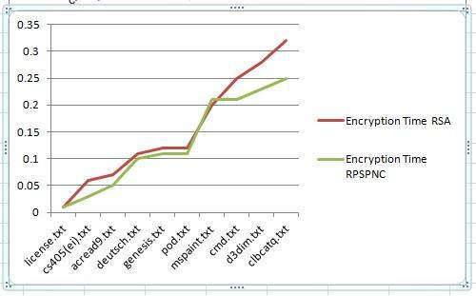
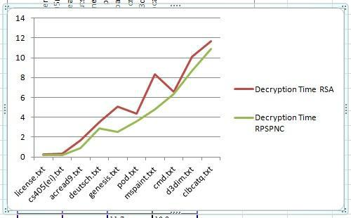
Contd.
Graphical Representation of Decryption time
Graphical Representation of Encryption time

Slide 21
AVALANCHE RATIO TEST
 |  | Avalanche
Source File | File Size | Ratio(in
 | (Bytes) | Percentage)
 |  | RSA | RPSPNC
license.txt | 17,632 | 58.0 | 88.8
cs405(ei).doc | 25,422 | 60.0 | 88.0
acread9.txt | 35,121 | 75.0 | 88.8
deutsch.txt | 47,829 | 78.9 | 95.5
genesis.txt | 49,600 | 80.9 | 95.5
pod.exe | 69,981 | 58.0 | 95.0
mspaint.exe | 136,463 | 58.9 | 96.5
cmd.exe | 152,028 | 67.0 | 95.0
d3dim.dll | 193,189 | 67.9 | 95.0
clbcatq.dll | 403,901 | 68.0 | 95.5
The avalanche ratio of RSA and RPSPNC

Slide 22
TE VS DES Entropy test
Serial no. | File name | File size | Entropy
 |  |  | DES |  |  | TE
 |  |  | Actual | Max | % | Actual | Max | %
1 | Input.txt | 2kb | 8.00 | 7.83 | 98.75 | 4.70 | 4.23 | 90
2 | Om.jpg | 12KB | 8.00 | 7.84 | 98 | 8.00 | 7.58 | 94.75
3 | bb.exe | 25kb | 8.00 | 7.67 | 95.87 | 8.00 | 6.49 | 81.12
4 | Out.dll | 132kb | 8.00 | 7.98 | 99.75 | 8.00 | 7.59 | 94.87

Slide 23
N-gram analysis
Serial no. | File name | File size | DES | TE
1 | Input.txt | 2kb | 11.11 | 10.00
2 | Om.jpg | 12KB | 0.62 | 0.54
3 | bb.exe | 25kb | 1.06 | 1.05
4 | Out.dll | 132kb | 0.49 | 0.32

Slide 24
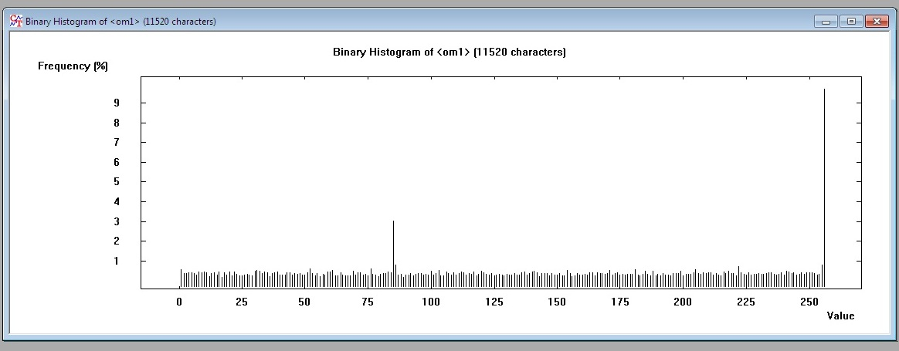
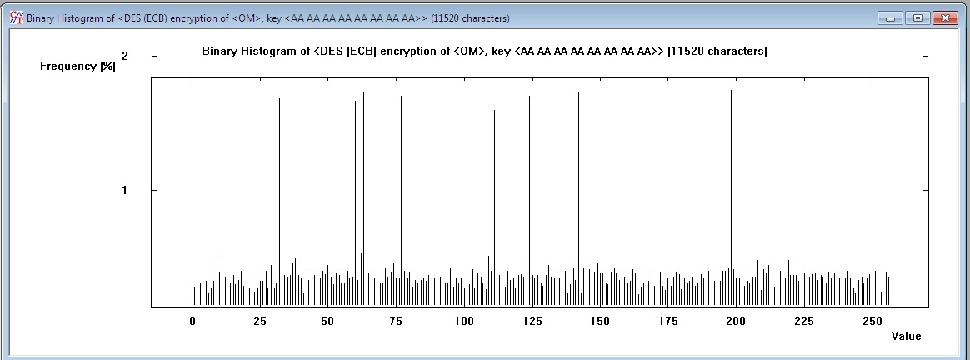
Frequency distribution graph
shows the frequency distribution graph of proposed technique encrypted file
shows the frequency distribution graph of DES encrypted file

Slide 25
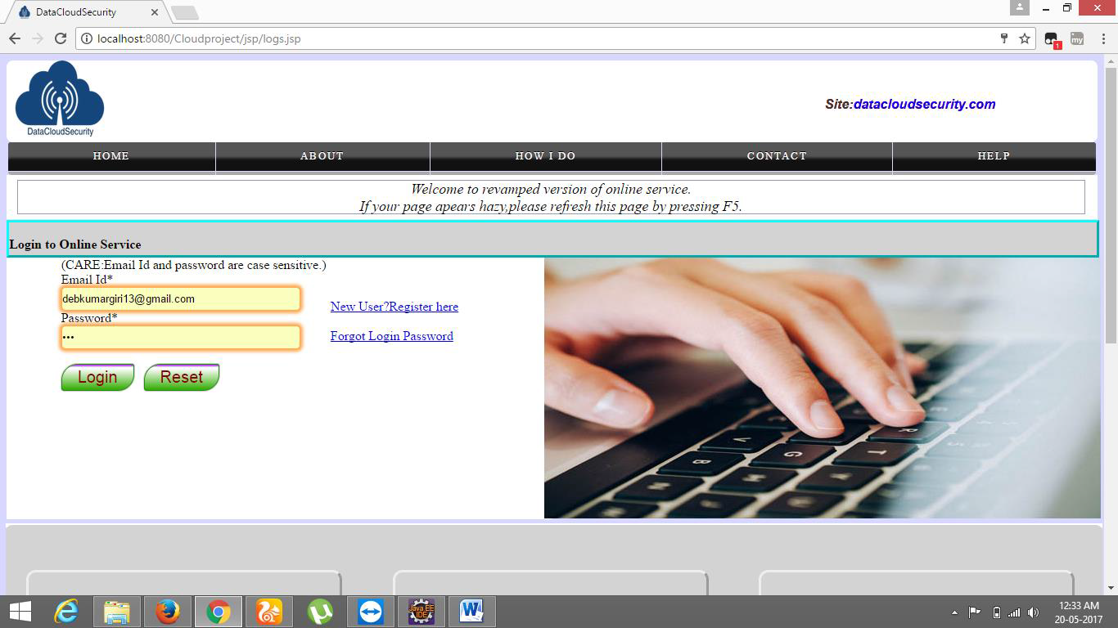
Screenshots- Login Page

Slide 26
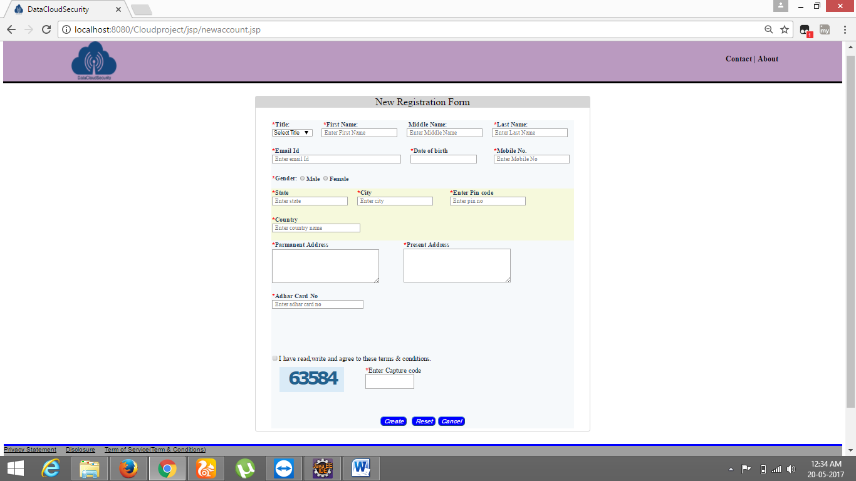
Registration Page

Slide 27
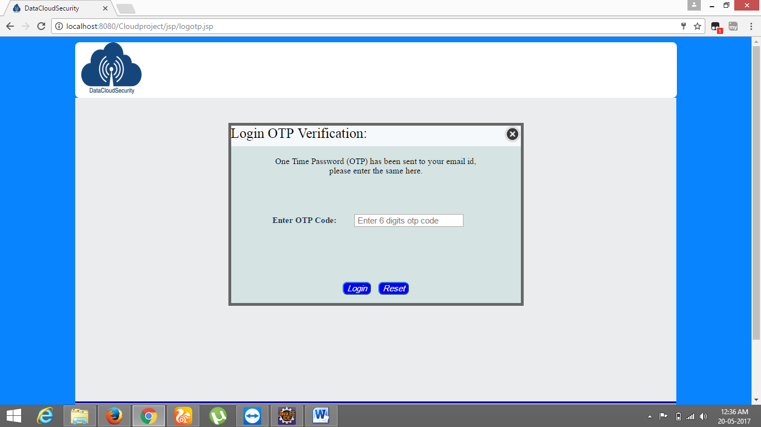
OTP Verification

Slide 28
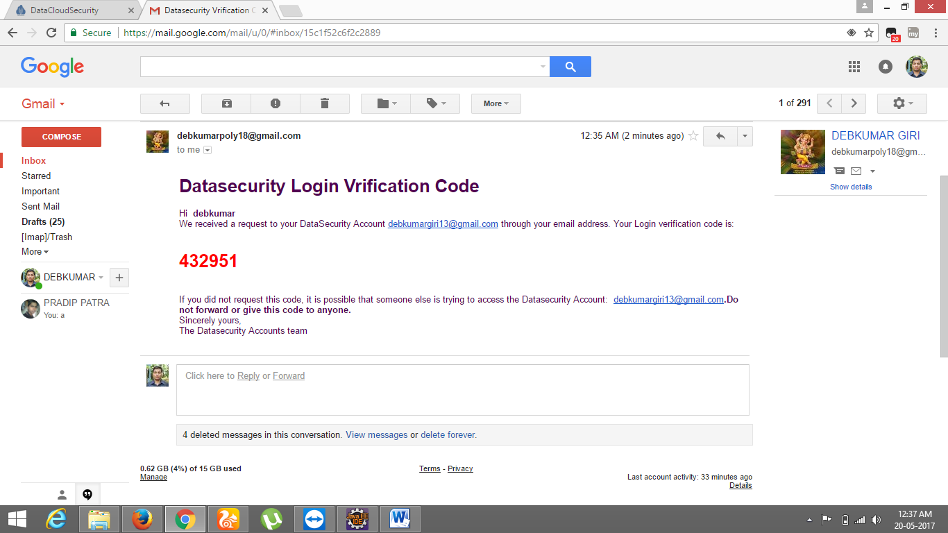
Sending OTP in registered e-mail

Slide 29
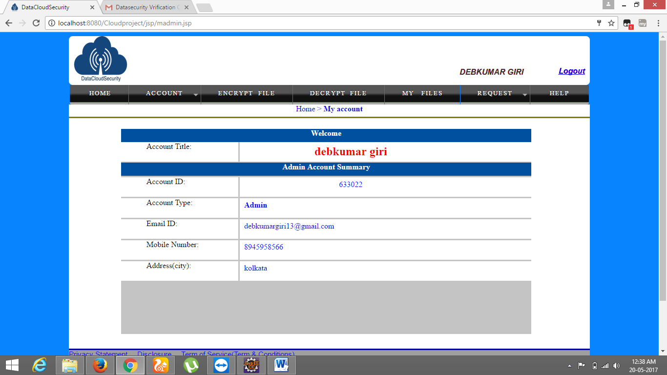
Home page(Admin):

Slide 30
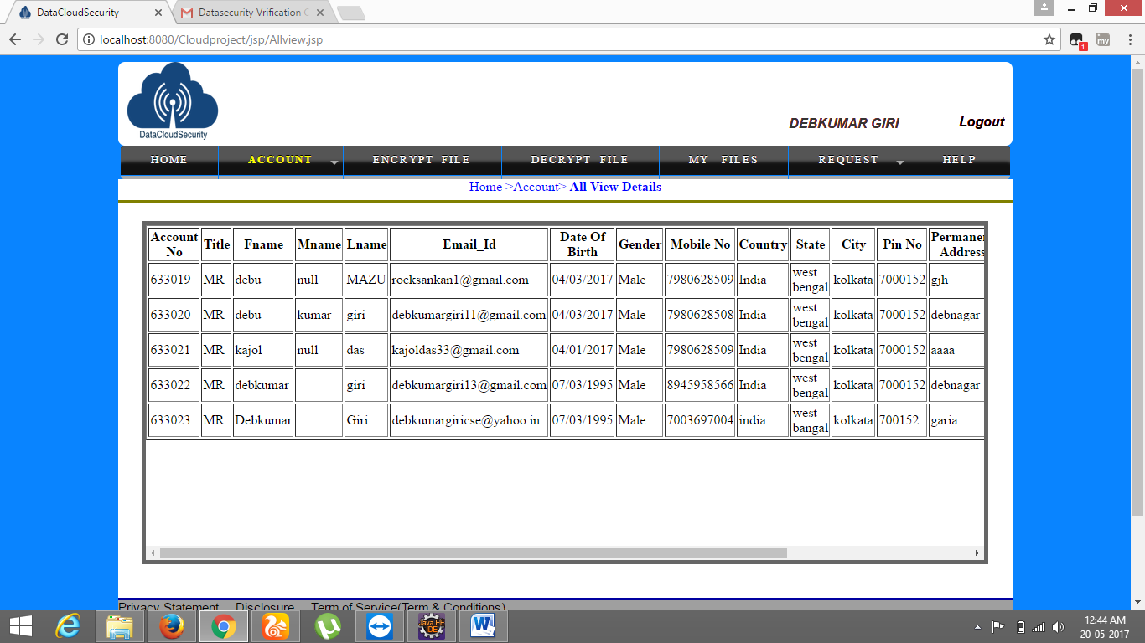
Continued:-

Slide 31
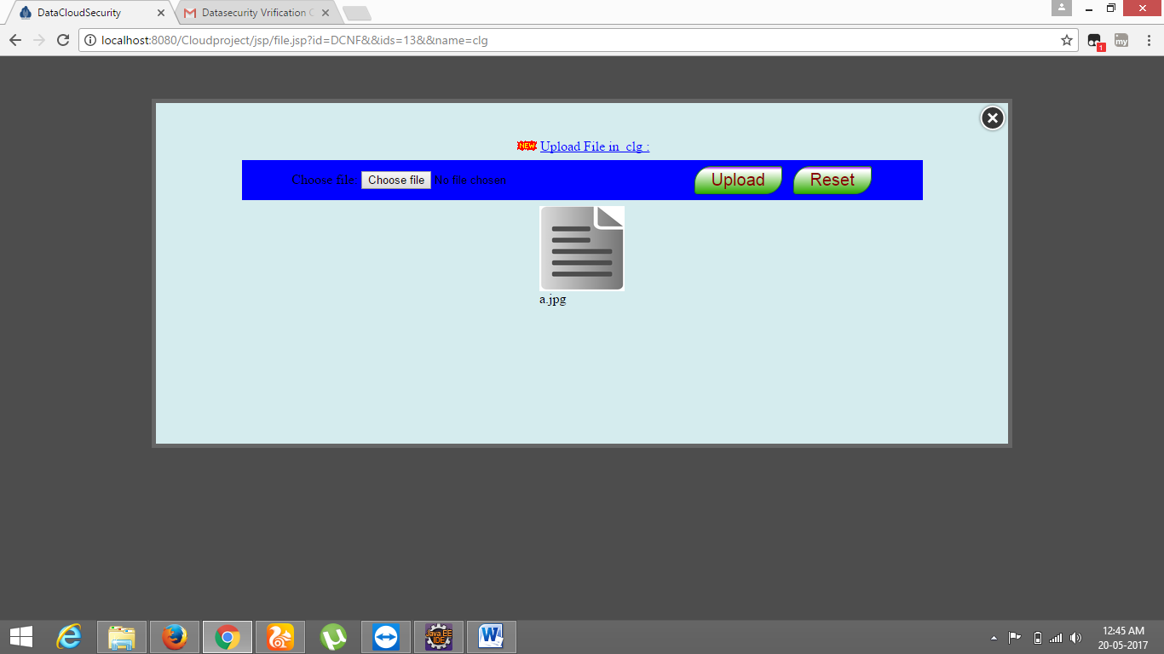
File upload in cloud server:

Slide 32
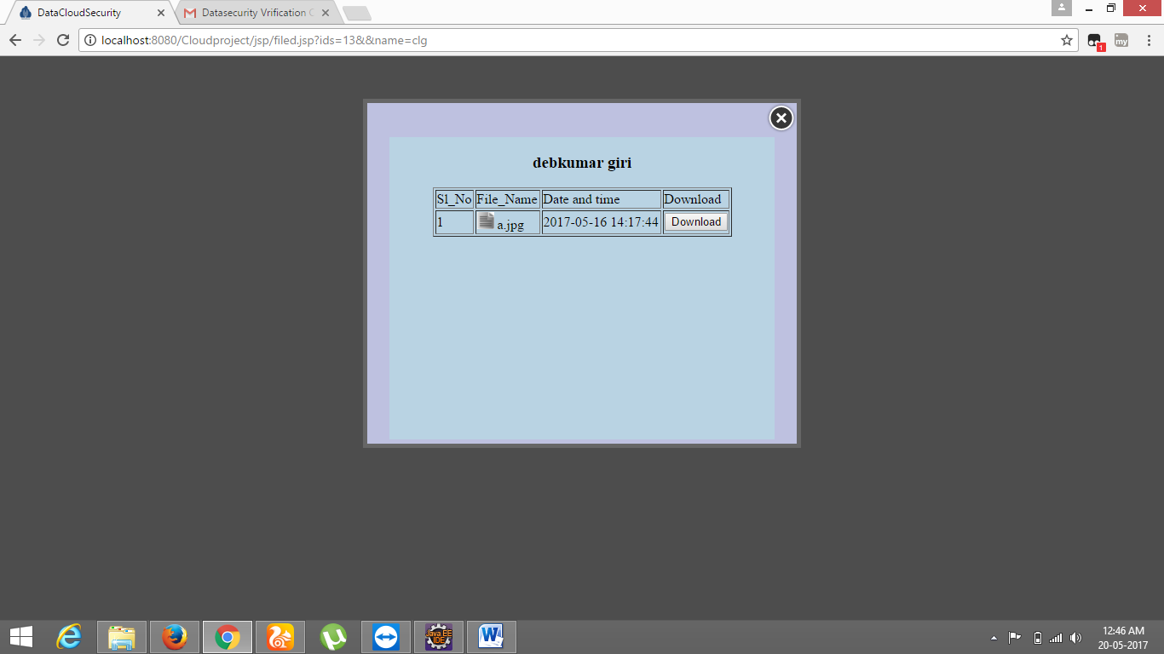
Show all upload file for download:

Slide 33
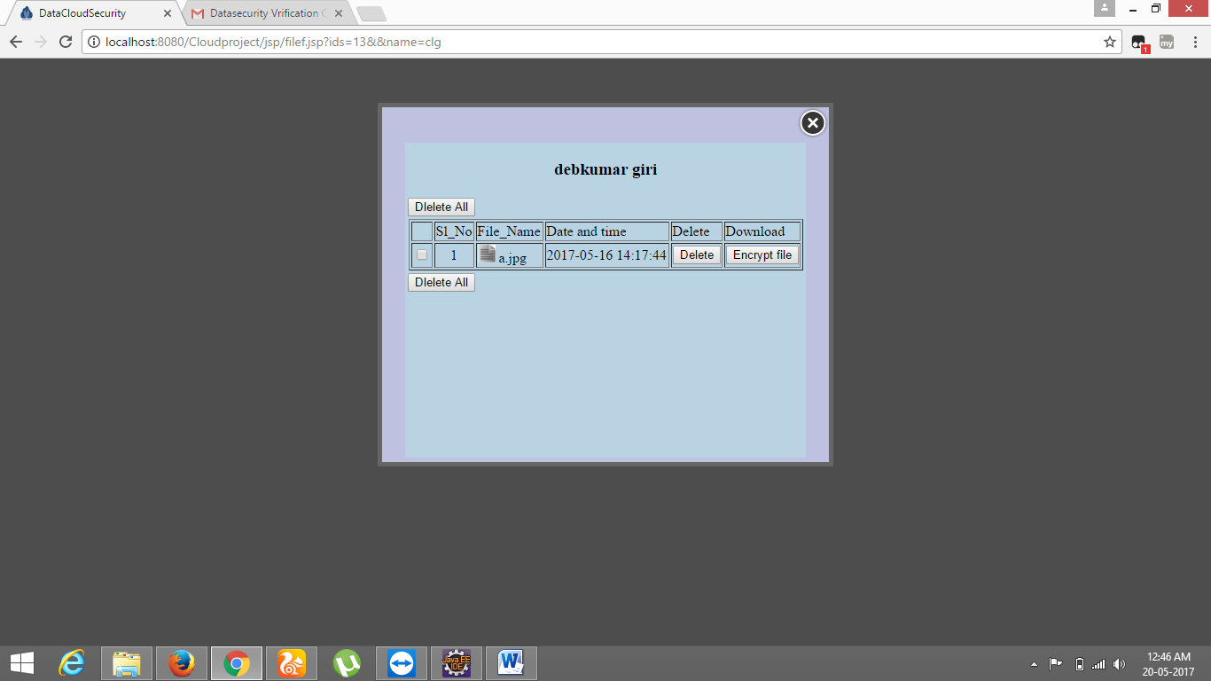
Multiple file delete and show encrypted file:

Slide 34
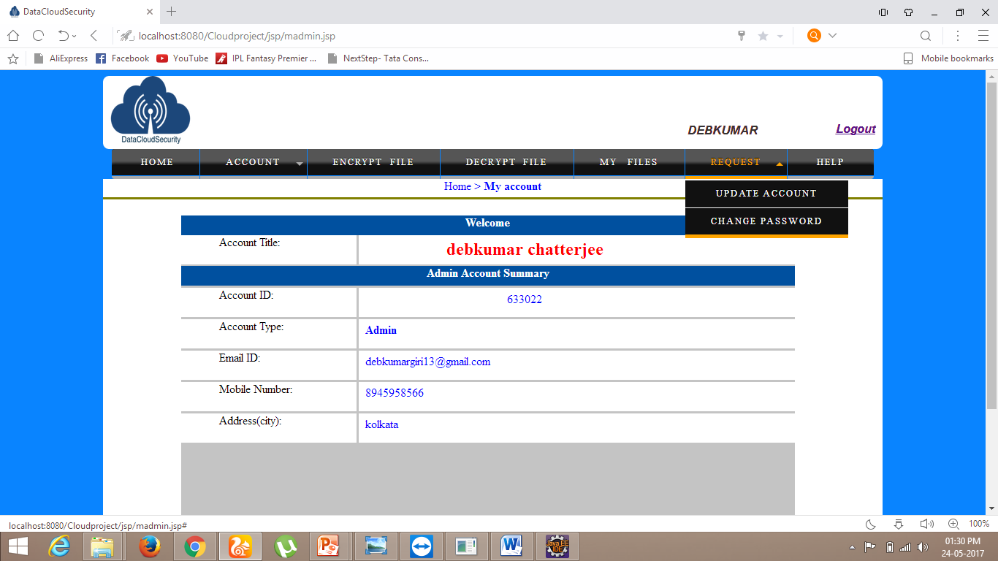
Update Any account details:

Slide 35
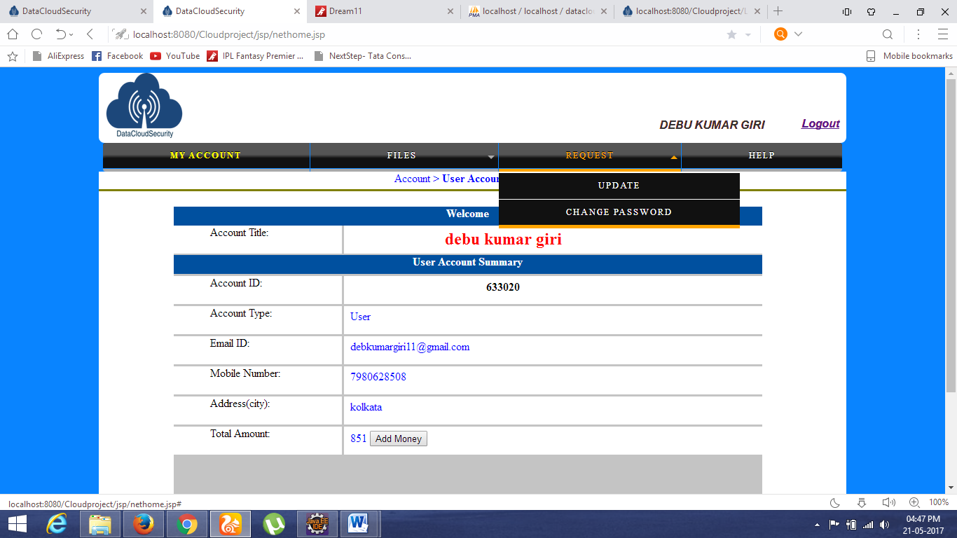
User Home Page

Slide 36
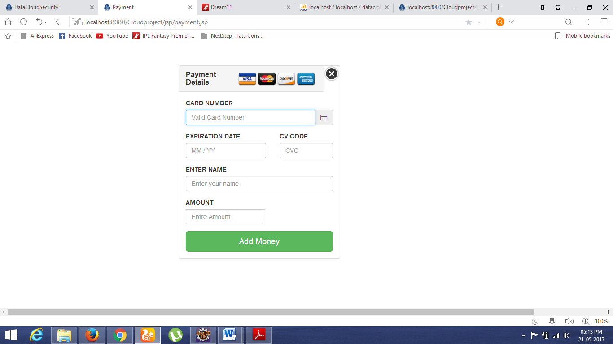
User Add Money page:

Slide 37
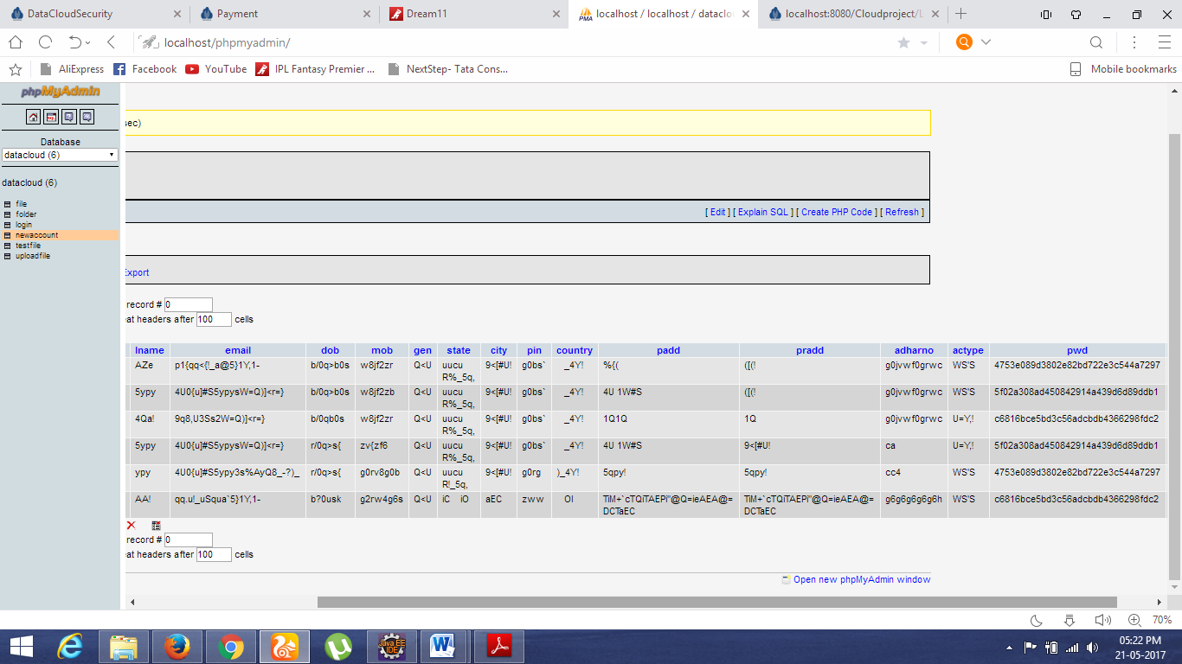
Encrypted data store:

Slide 38
Advantage:- Advantages
Encryption is done with secured symmetric or asymmetric encryption algorithms.
More security and flexibility on data for permission.
Segmentation of data provides an enhanced level of security control over the encrypted data.
Reliability

Slide 39
Future Work
In future, we want to work with ensuring secure communication system between users and system, user to user, client & servers.
Working with 128 bit encryption.
OTP can be send through sms along with email.
Payment system can be improved.
We also want to work with encryption algorithms to find out more light and secure encryption system for secured file information preserving system.

Slide 40
CONCLUSION
Newer & enhanced security structure for cloud environment.
TE(Triangular Encryption) file encryption system,
RPSP system for secure communication,
OTP(One time password) to authenticate users
MD5 hashing for hiding password information.
Hence, very difficult for an intruder to get control & information

Slide 41
References
Network Security and Cryptography by-Himanshu Gupta.
Yashpal Kadam, ―”Security Issues in Cloud Computing A Transparent View”, International Journal of Computer Science Emerging Technology, Vol-2 No 5 October, 2011 , 316-322 .
Cloud Computing: Silver Lining or Storm Ahead?‖, Volume 13 Number 2, Spring 2010 .
www.ijsr.net
, ‖,

Slide 42


